Slide 1

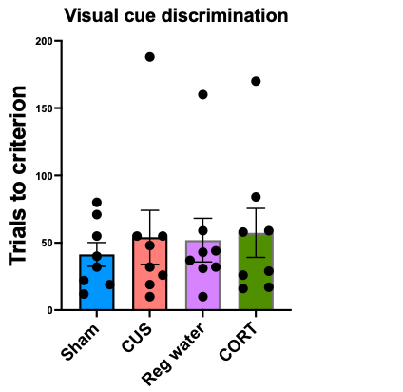
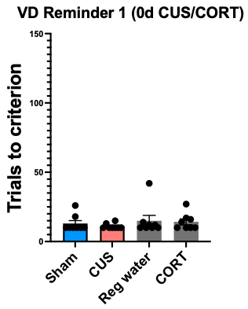
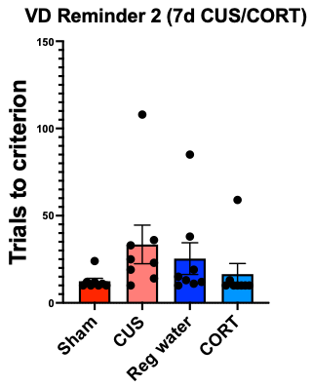
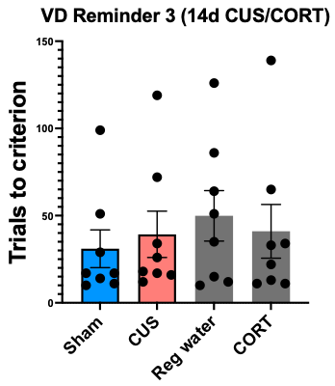
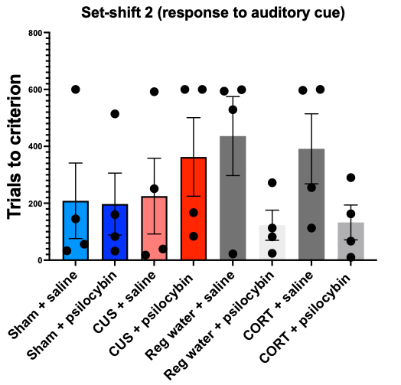
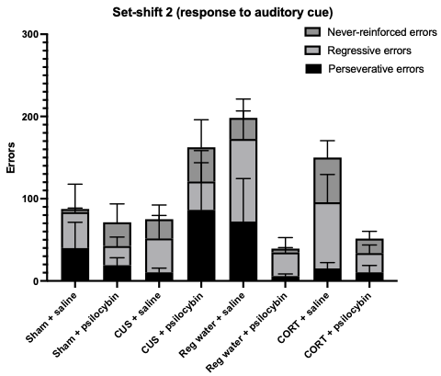
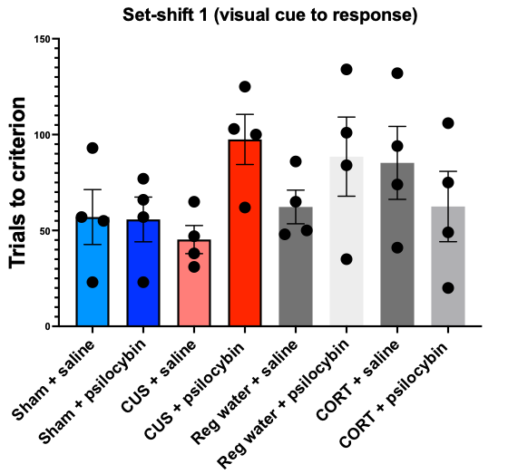
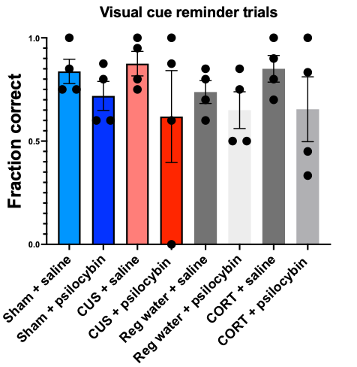
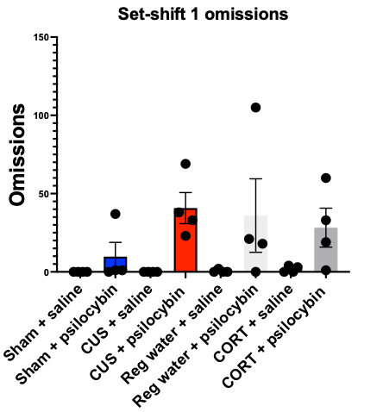
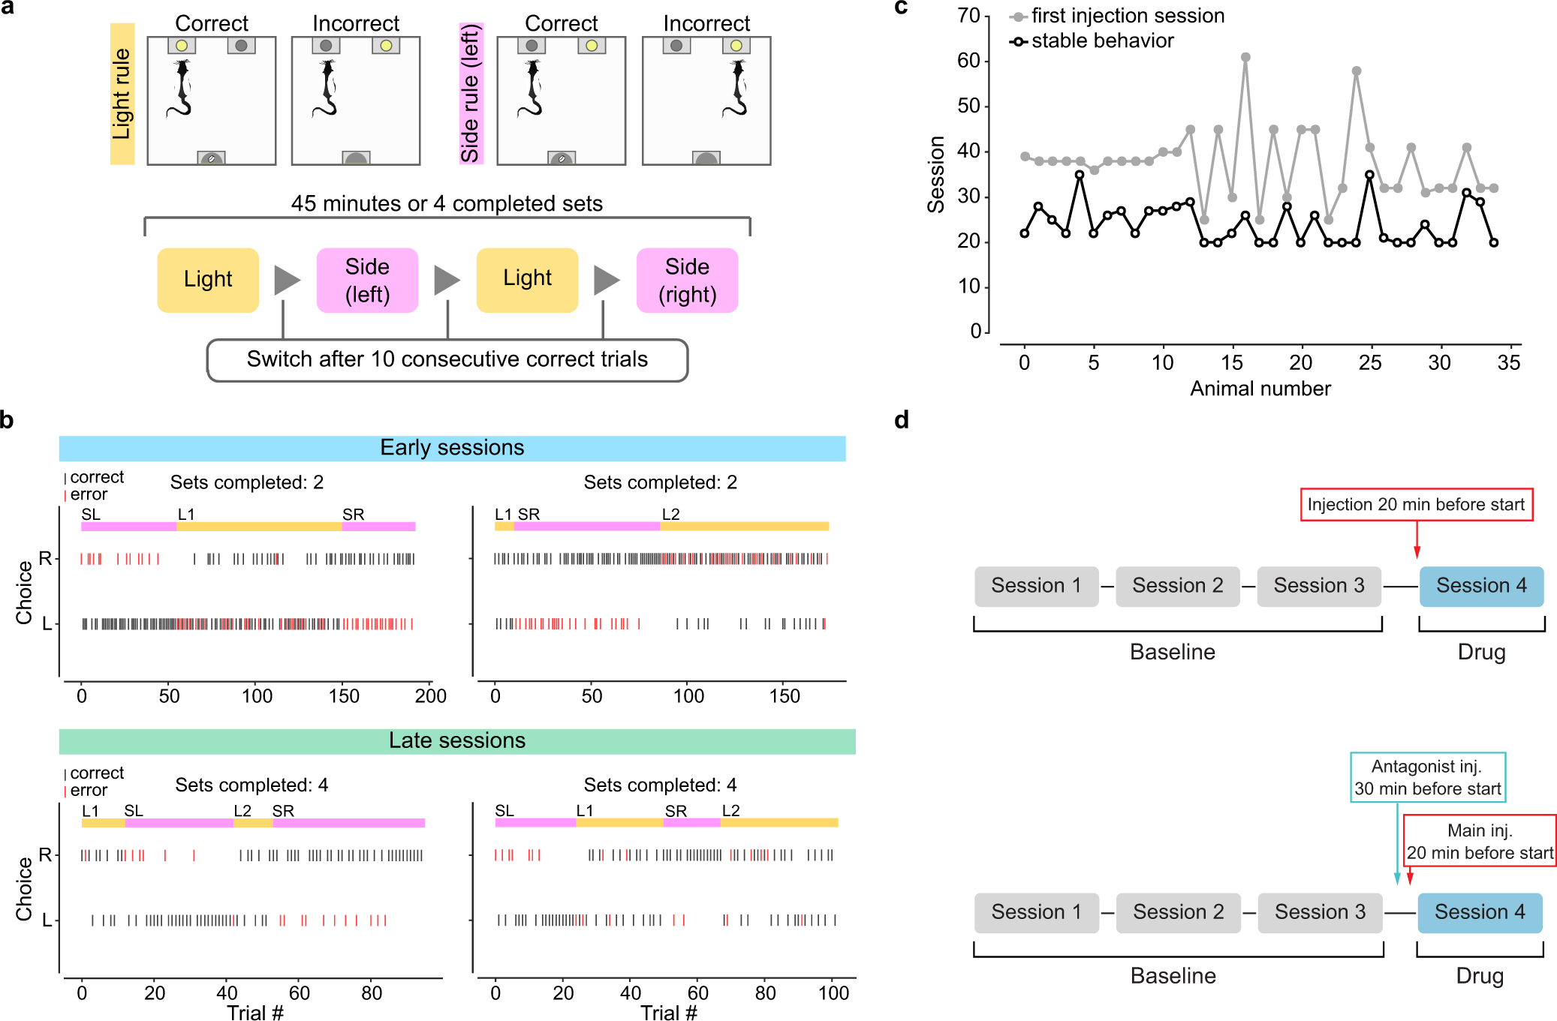
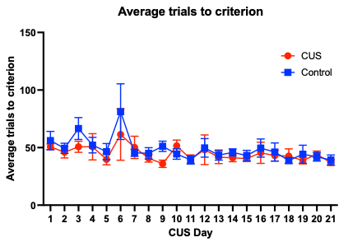
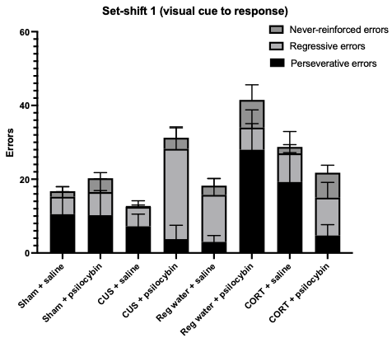
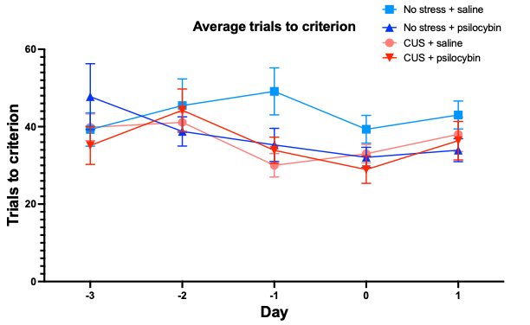
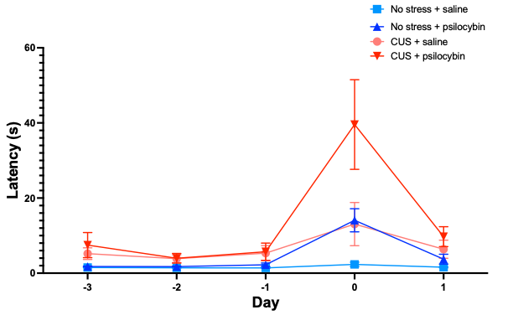
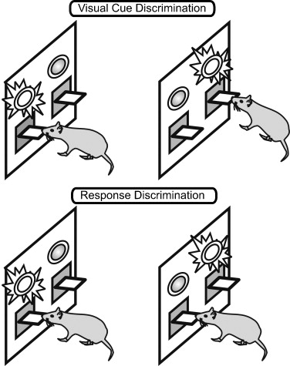

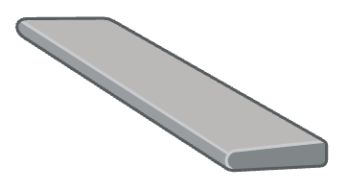


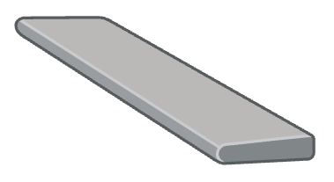



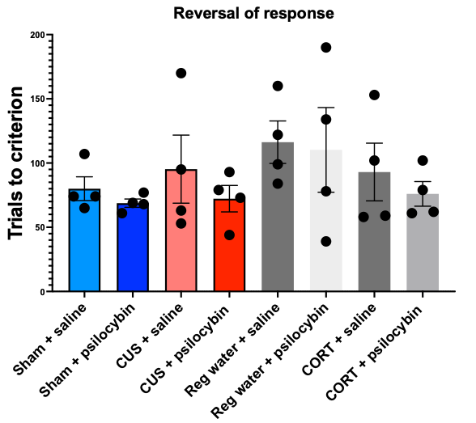
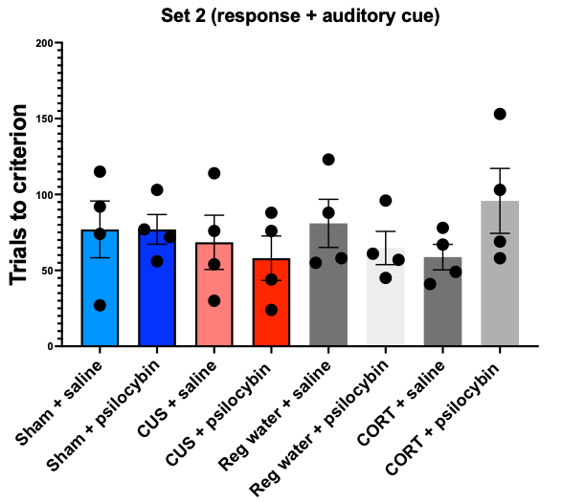
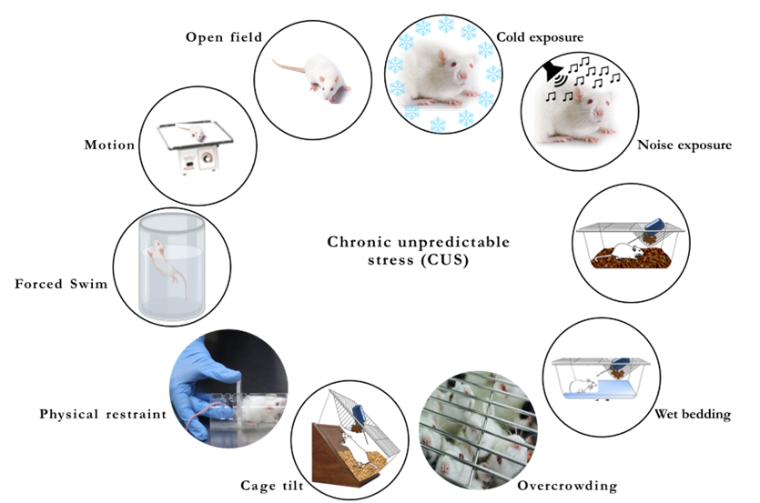
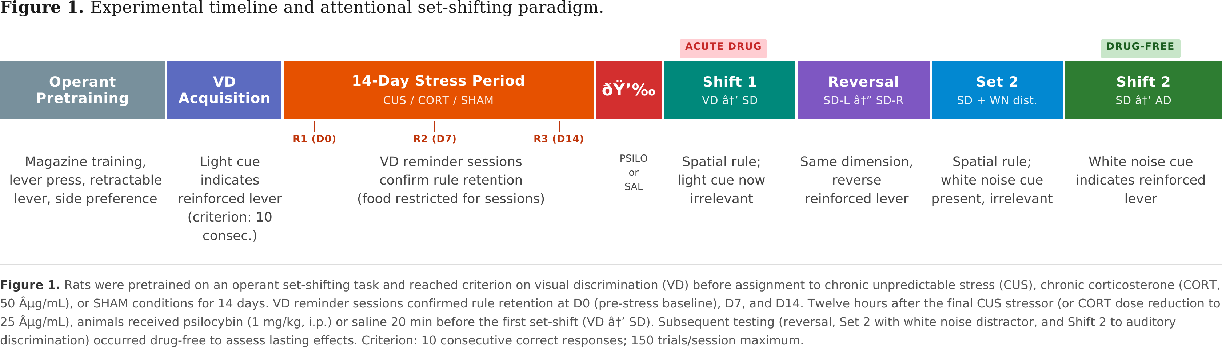
Effects of psilocybin on attentional set-shifting following chronic stress in rats
Joseph J. Hennessey^{1,2}, John D. McCorvy³, & John R. Mantsch¹
Department of Pharmacology & Toxicology¹; Medical Scientist Training Program²; Department of Cell Biology, Neurobiology, and Anatomy³,
Medical College of Wisconsin, Milwaukee, WI
Introduction
Visual cue performance
Stress paradigm-specific effects of psilocybin on delayed set-shift performance
Psychedelics are a class of compounds that acutely induce profound alterations in perceptual, emotional, and cognitive state primarily through agonist action at serotonin 2A (5-HT2A) receptors
Psychedelic-assisted therapy is showing promise for treating a wide range of neuropsychiatric diseases, including Major Depressive Disorder, Substance Use Disorder, PTSD, and Obsessive-Compulsive Disorder (Stange 2017, Verdejo-Garcia 2015, Gruner 2017, Polak 2012)
Psychedelic-assisted therapy is unique in that it provides long-term therapeutic benefits after a single or several doses
Cognitive flexibility is impaired in all these diseases (MDD, SUD, PTSD, OCD)
Psychedelics have been shown to promote cognitive flexibility and relaxion of prior beliefs in humans (Doss 2021, Carhart-Harris 2019)
Thus, promotion of cognitive flexibility may represent a trans-diagnostic therapeutic mechanism through which psychedelics mediate their long-term effects
A:
B:
A:
Trials to criterion (10 consecutive correct) on the visual cue discrimination (VD) task. Reminder sessions occurred on D0, D7, and D14 of CUS/CORT
Hypothesis
General acute performance impairments with psilocybin and CUS/psilocybin
Chronic unpredictable stress (CUS) will induce deficits in cognitive flexibility, assayed with an attentional set-shifting paradigm
Psilocybin (1 mg/kg) will promote cognitive flexibility acutely and chronically in stressed rats
A:
B:
C:
(A) Trials to criterion (10 consecutive correct) for set-shift 2 (response to auditory cue). Auditory cue was a 76-77 dB white noise played from a speaker above either the left or right lever, depending on the trial. (B) Error analysis for set-shift 2, as described previously. Data represent mean ± SEM.
Effects on familiar attentional set-shifts
A:
B:
Methods
32 male Sprague-Dawley rats (9-10 weeks on arrival) were pair-housed and food restricted to 90% free-feeding weight and pretrained on an operant-based attentional set-shifting task (Floresco et al. 2008) through criterion (10 consecutive correct) to visual cue. Rats were subjected to sham or CUS conditions for 14d, with weekly visual cue reminder sessions occurring in the morning before any stressor. Animals were administered psilocybin (1 mg/kg, i.p.) or saline 12h after the final stressor; 20 minutes later, a set-shift was introduced (Set-shift 1, visual cue to response). If the set shift was not completed on day 1, up to two more sessions were given. On subsequent days, a reversal of response was performed as well as a response discrimination with a white noise cue as a distractor. Finally, a second set shift (response to white noise cue) was performed 5-8 days after psilocybin administration.
D:
C:
D:
(A) Trials to criterion on set-shift 1 (visual cue to response), which occurred 20min. post-psilocybin (i.p., 1 mg/kg) or saline. (B) Fraction correct on 20 visual cue reminder trials, excluding omissions, which were presented at the beginning of the set-shift 1 behavioral session. (C) Total omissions during the set-shift portion of the behavioral session by group. (D) Error analysis for set-shift 1 (visual cue to response), separated into perseverative, regressive, and never-reinforced. Perseverative errors were defined as errors which correspond to the previous “set” task (VD) until <6 were made in a block of 16 completed trials. Thereafter, errors were scored as regressive. Never-reinforced errors were errors that were never reinforced under either the “set” task (VD) or the “shift” (response).
Experimental design
Figure adapted from Floresco et al. 2008 Beh Brain Res
Attentional set-shifting:
Novel “auditory discrimination” (white noise cue)
(A) Task diagram. (B) Average trials to criterion through 21d CUS paradigm. (C) 3-day baseline, psilocybin (1 mg/kg) followed by acute set-shifting performance 20min. later, and 24h set-shifting performance. (D) Latency to respond by group
No effects on reversal of response or attentional set formation
Future Directions
e
A:
B:
Pretrain only through speed response training, complete visual cue discrimination post-CUS/CORT
Administer psilocybin 24h before Set-shift 1 to avoid acute behavioral confounds
Interrogate receptor contributions with novel 5-HTR subtype-selective compounds
Dendritic spine imaging in PrL
Chronic unpredictable stress:
Conclusions
e
Visual cue pretraining may mask CUS deficits in cognitive flexibility
Psilocybin’s effects differ between chronic stress models
Psilocybin (1 mg/kg) acutely interferes with attentional set-shifting, prior rule recall, and general operant responding
CUS and psilocybin seem to have synergistic detrimental effects on task performance both acutely and chronically, with different error patterns under acute psilocybin vs. after drug washout.
CUS, CORT, and psilocybin do not affect delayed (24h) reversals or attentional set formation
Timeline:
Acknowledgements: This work was supported by NIH R01 MH136708 to JRM and NIH R01 MH133849 to JDM. I would also like to thank the Heffter Research Institute and the Steven and Alexandra Cohen Foundation for travel support.
(A) Trials to criterion (10 consecutive correct) for the reversal of response, i.e. a shift from the right to left lever being reinforced or vice versa. (B) Trials to criterion on Set 2, a response discrimination opposite the reversal task but with a white noise auditory cue instead of a light cue.

